Slide 1

A MINI PROJECT
ON
E-Commerce
By:-
Mayureshwar Shinde (57)
Viraj Taywade (63)
Vrushabh Suradkar (62)
Vinaykumar Singh (60)
Under the guidance of:-
Prof. SHATABDI BHALERAO

Slide 2
Table of Contents:
1] Introduction
2] Objective
3] Problem Statement
4] Software Requirements
5] Interface
6] Web Pages
7] App
8] Data Base
9] Web Host
10] Domain
11] Conclusion
12] Future Scope
13] Reference

Slide 3
INTRODUCTION
E-Commerce is the platform where person can buy or sell product online services over internet.
E-Commerce retail sales direct to consumers via web sites and mobile apps.
E-Commerce provides participating in online marketplaces.
Here Vkart E-Commerce provides 24x7 Online Shopping.

Slide 4
OBJECTIVE
To study the Online Buying and selling of products.
To make Buying and selling products more comfortable.

Slide 5
PROBLEM STATEMENT
The website was taking too much time to load .
To overcome issue we reduced the size of images and removed the intendation in
codes.

Slide 6






SOFTWARE’S USED:
FRONTEND
HTML 5
BOOTSTRAP 5
CSS 3
BACKEND
PHP 7
DATABASE
MY SQL

Slide 7





SOFTWARE’S USED:
Web Host
Domain
Name.com
TOOLS
VS Code
Xampp
Android Studio

Slide 8
INTERFACE:
The Vkart has:
The Responsive Webpage.
The App.
The Database.
Domain.

Slide 9
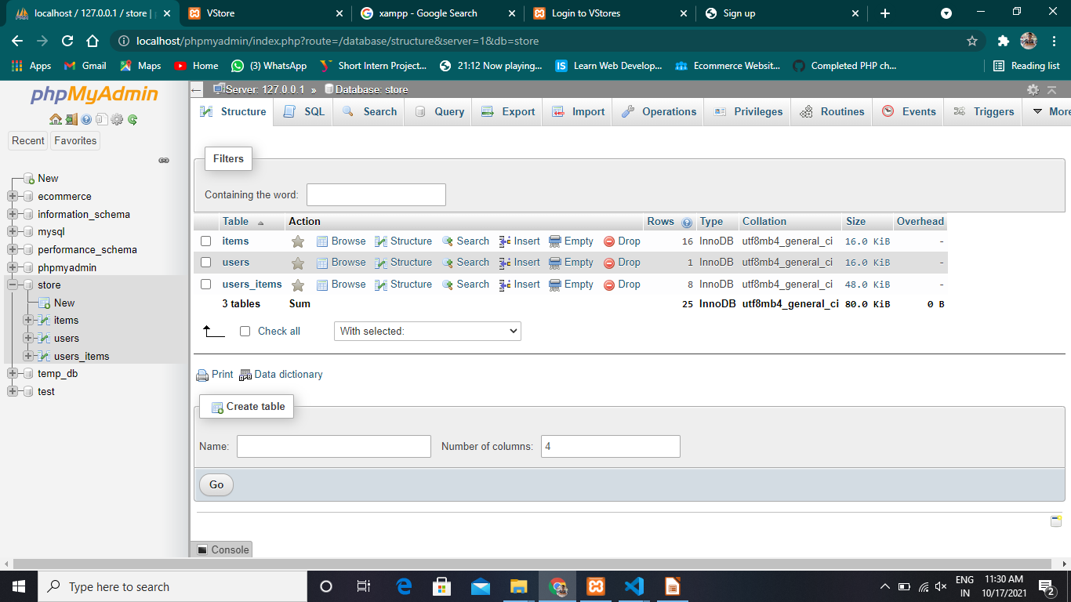
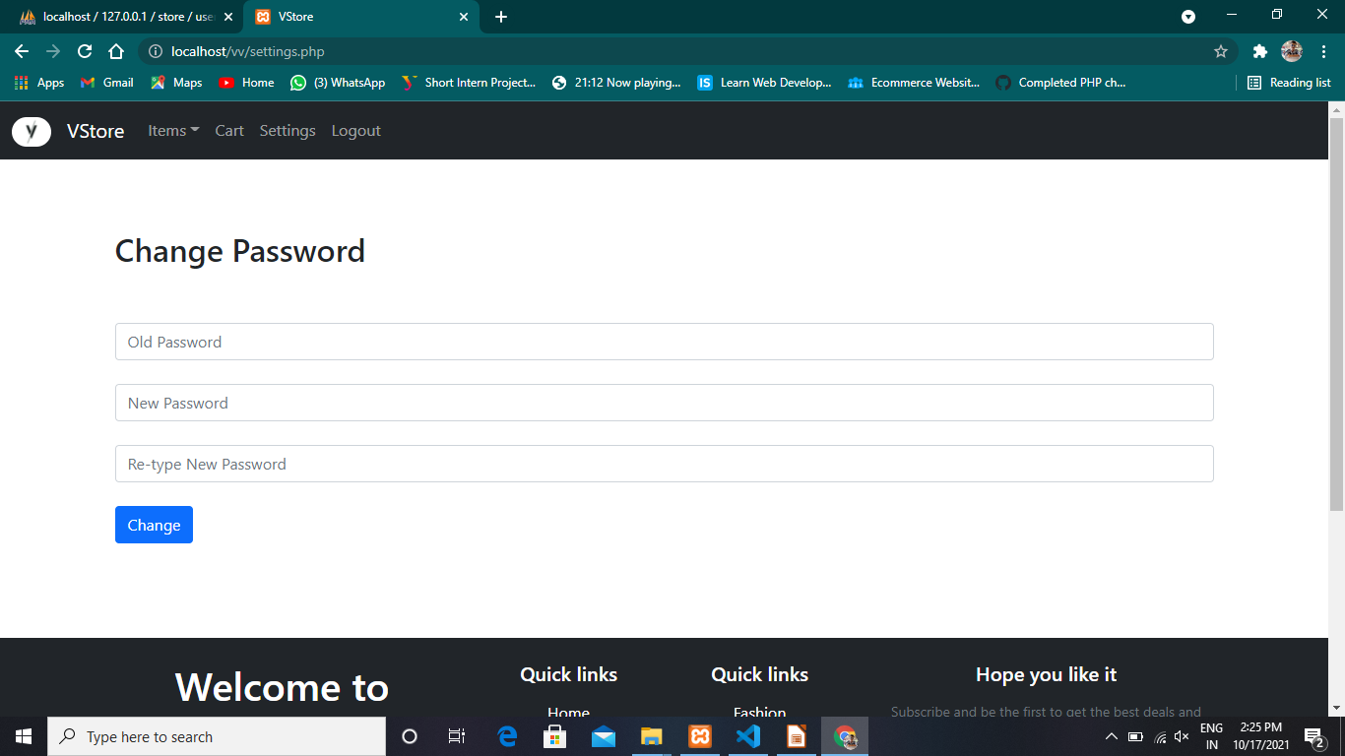

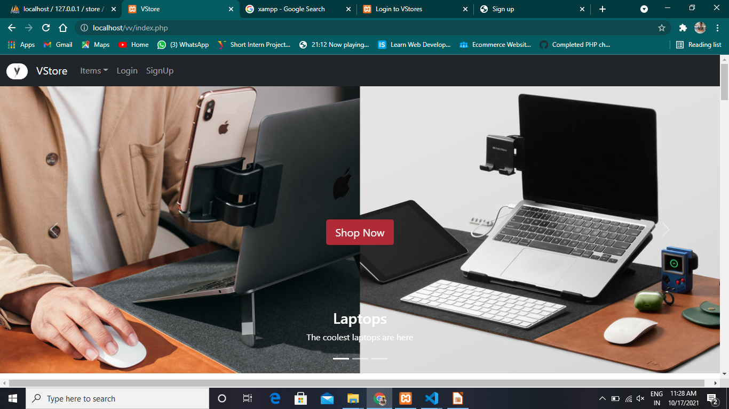
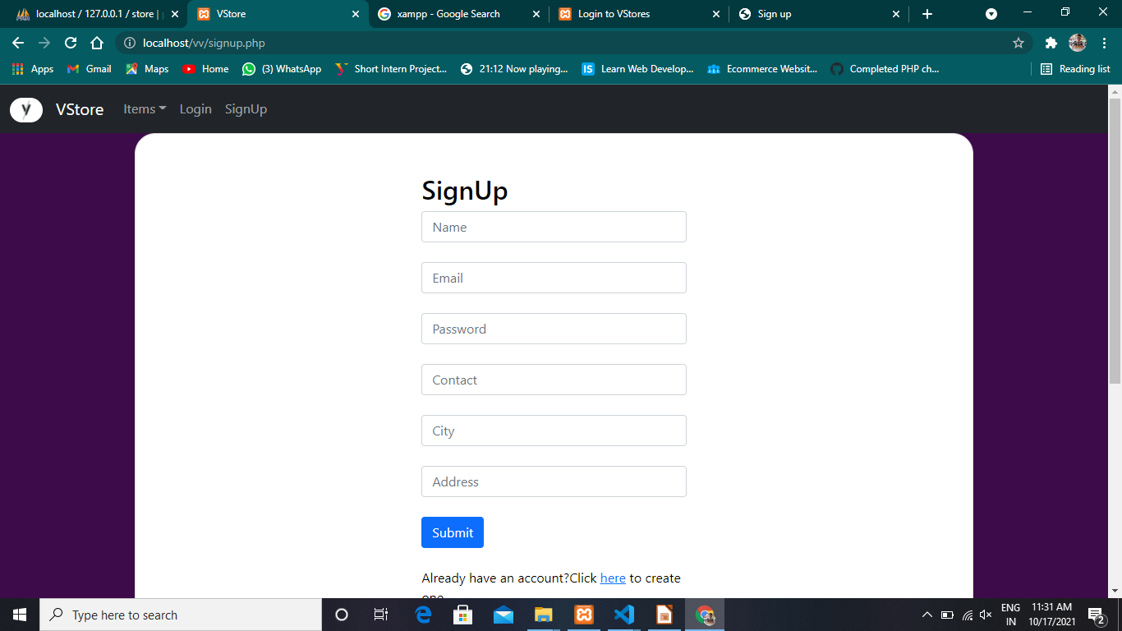
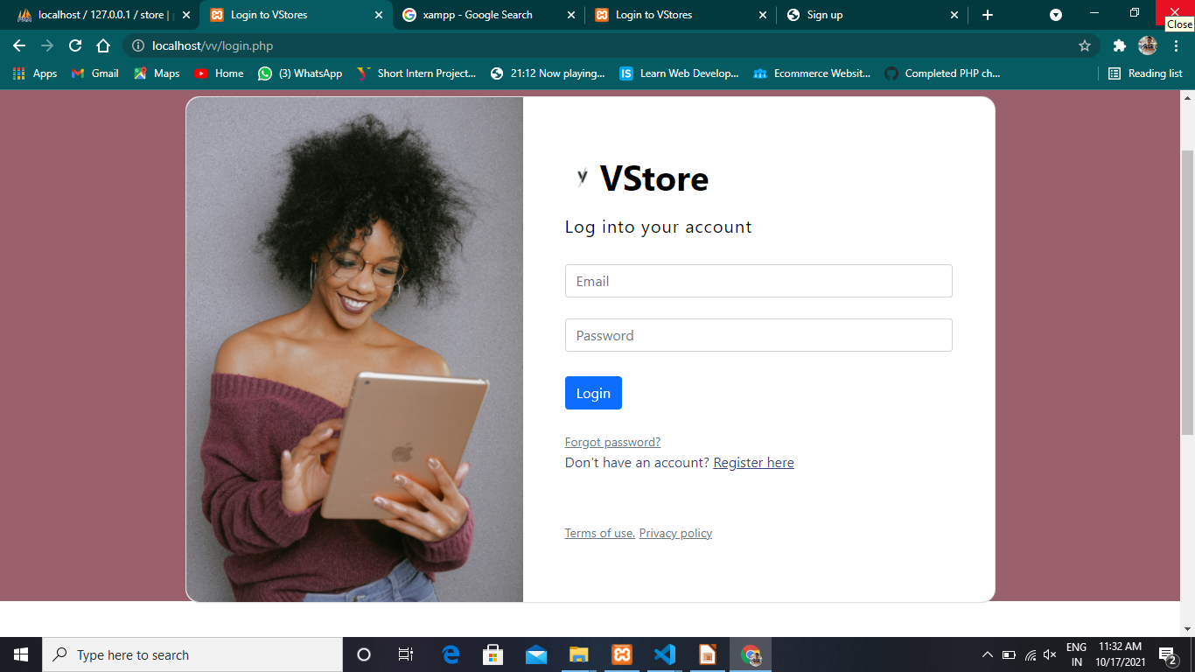
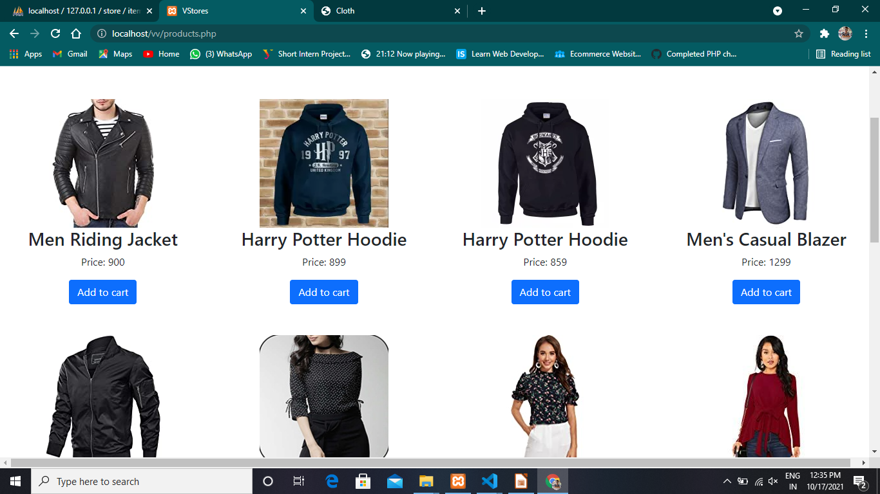
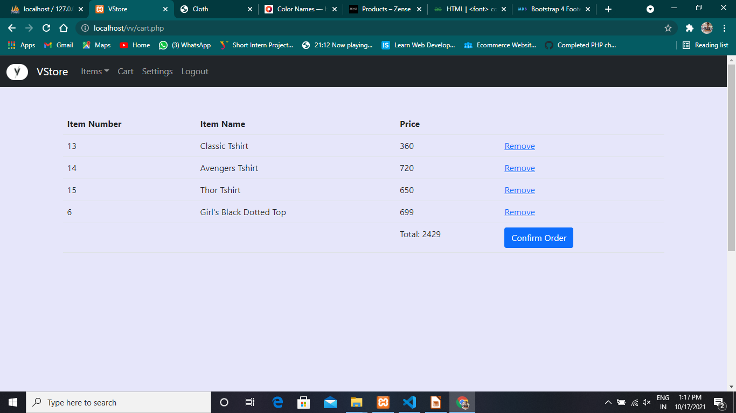
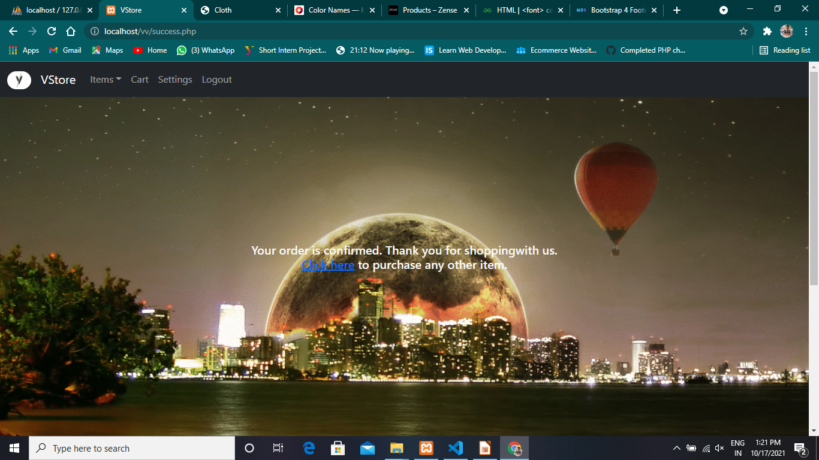
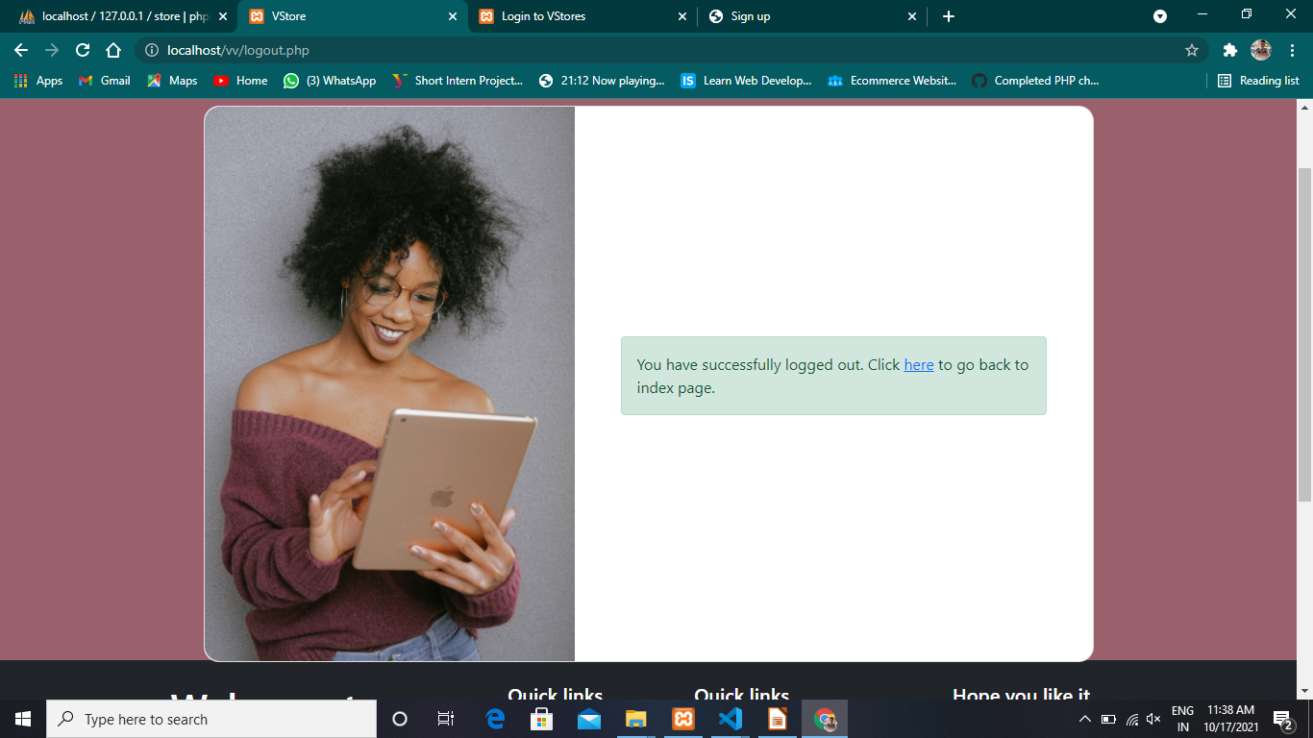
Web Page
1
10
Data Base
Setting
5
2
3
4
Setting
Home Page
Sign Up
Log In
8
9
6
7
Log Out
Product Page
Cart Page
Success Page

Slide 10
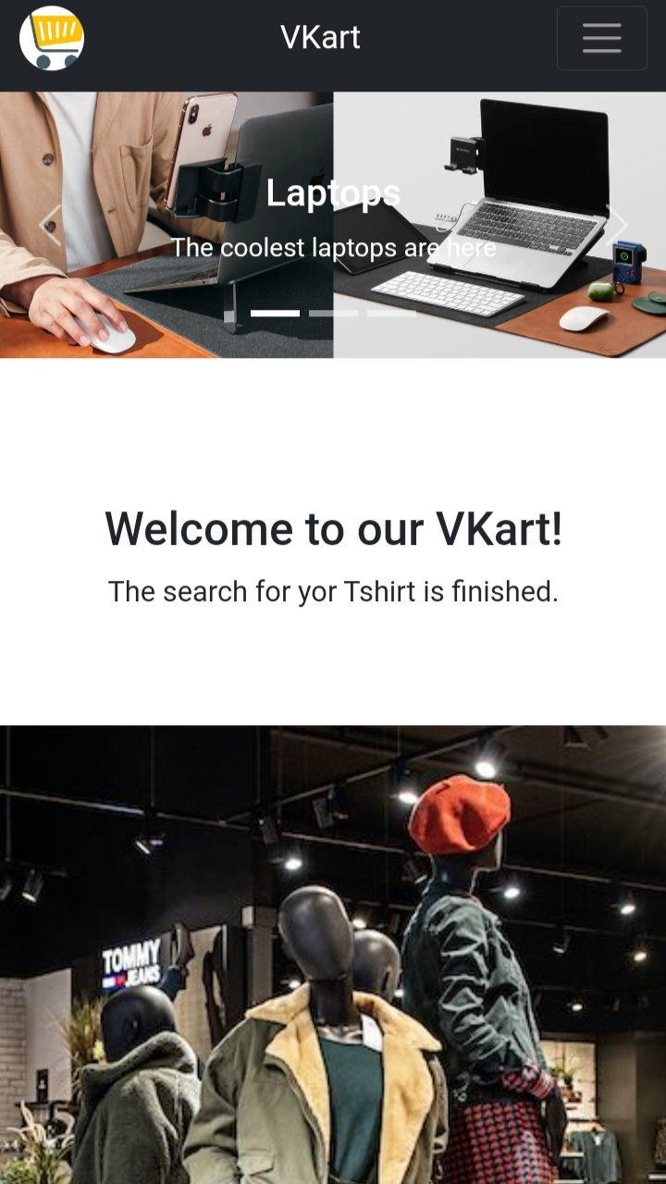
Web Page
The Website is Responsive.
It can be accessed with any device width or size.

Slide 11
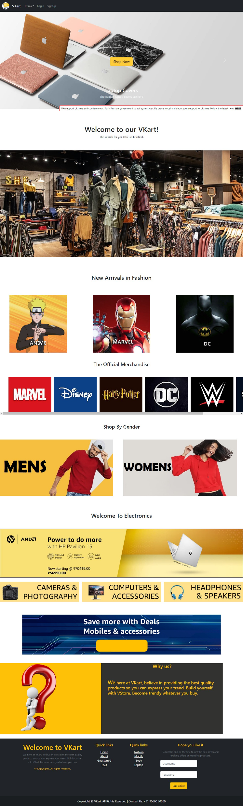
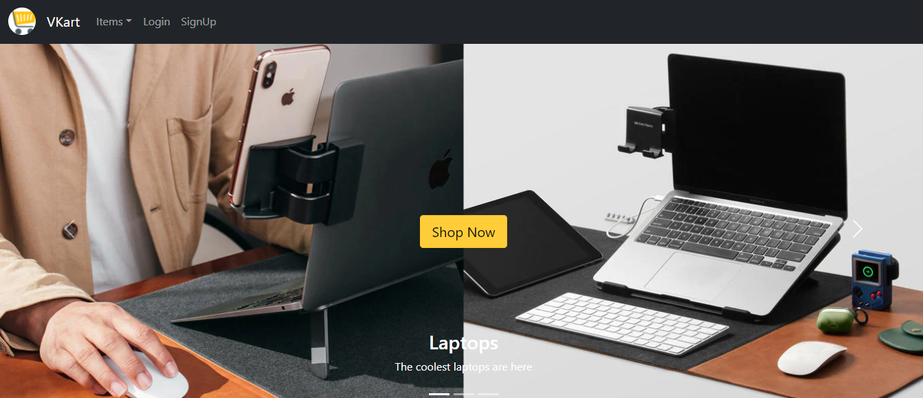
Web Page
Home

Slide 12
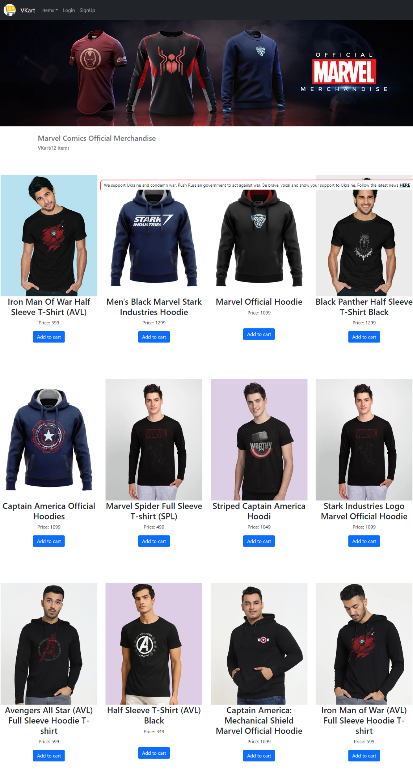
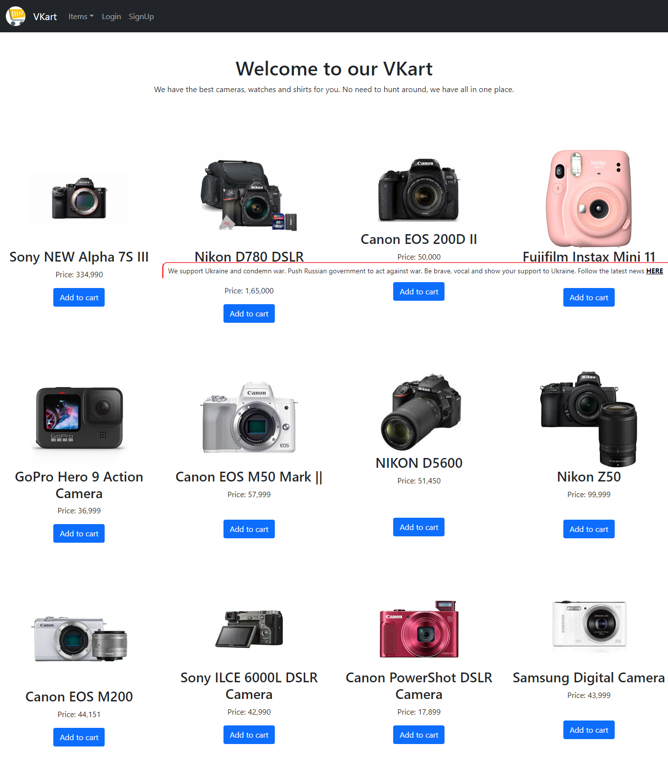
Web Page
Products Page

Slide 13
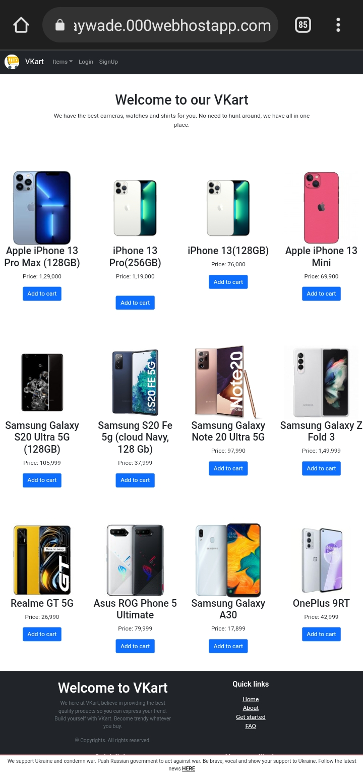
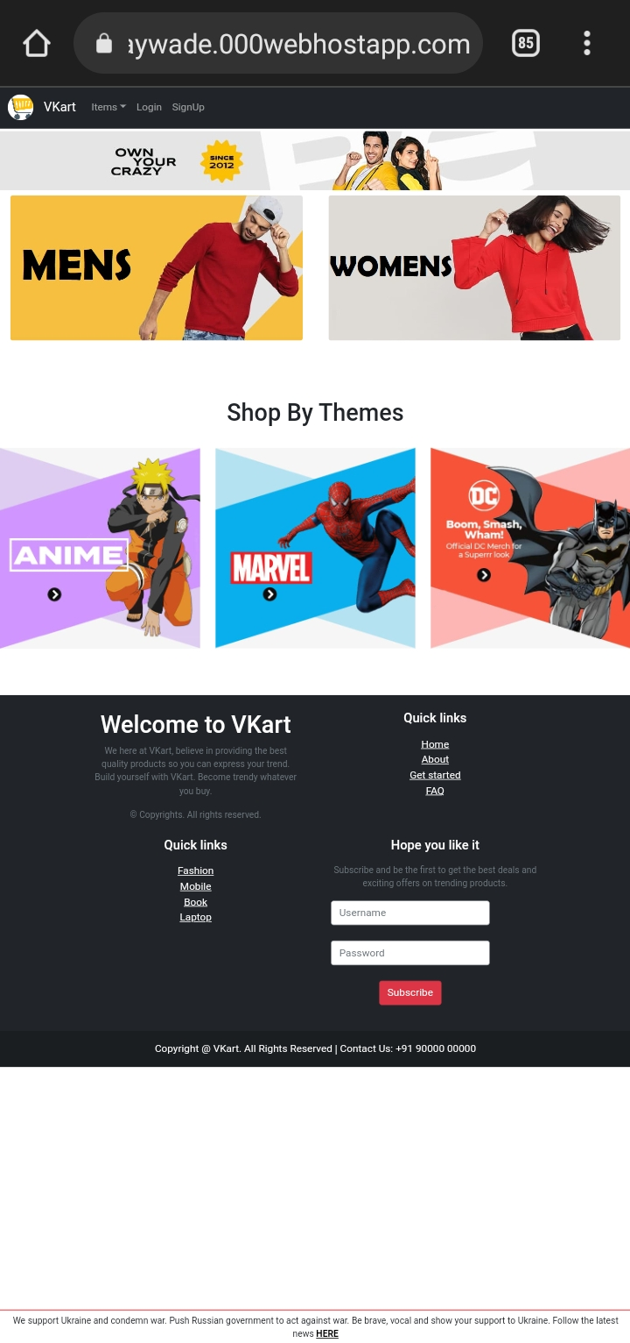
Web Page
Products Page

Slide 14
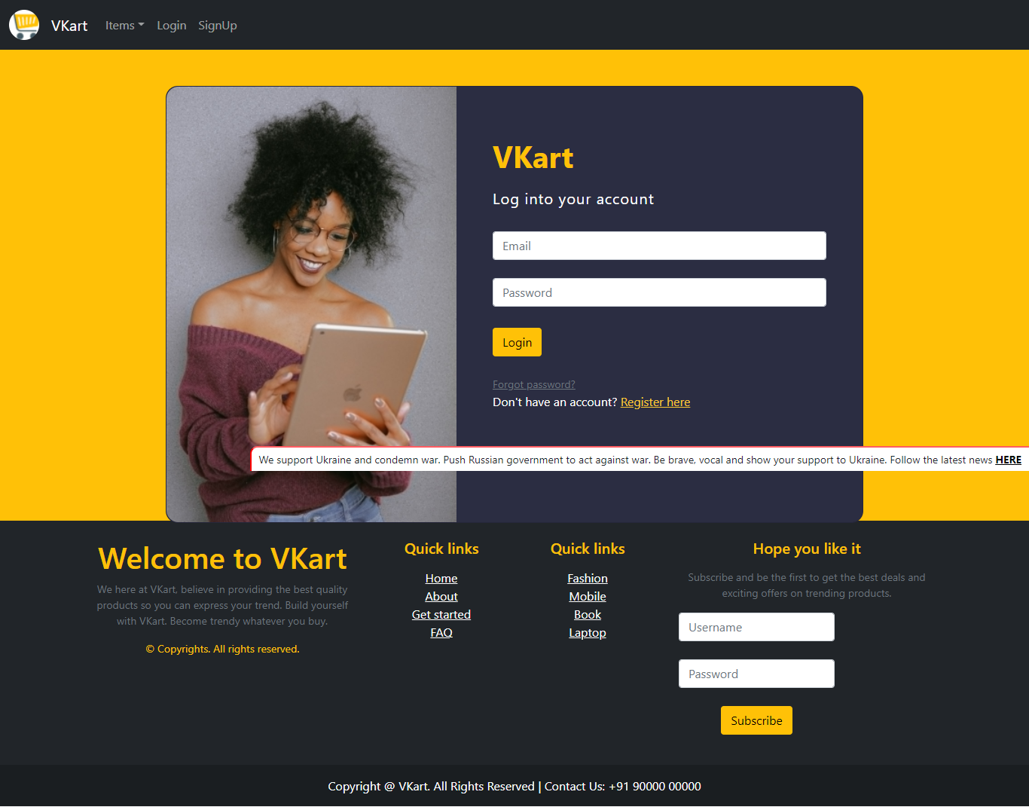
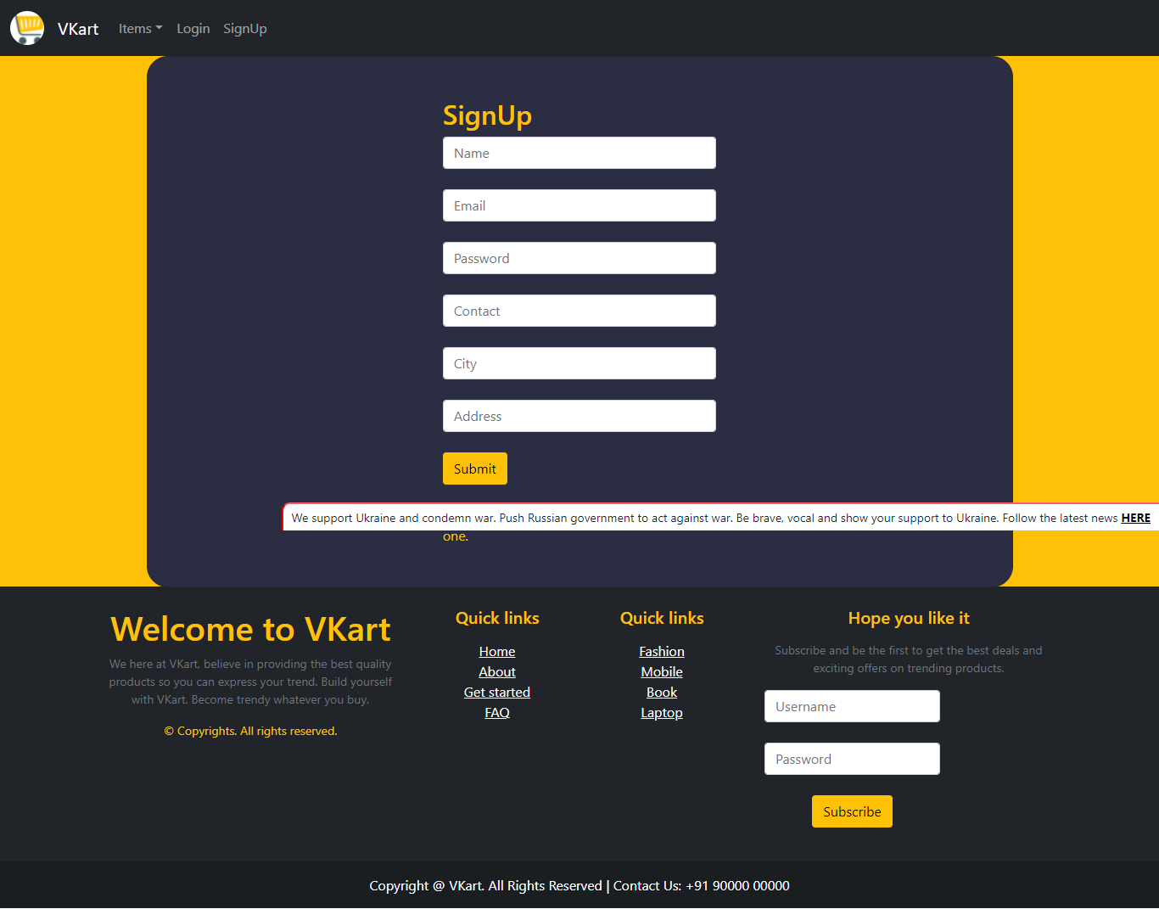
Web Page
Log In
Sign Up

Slide 15
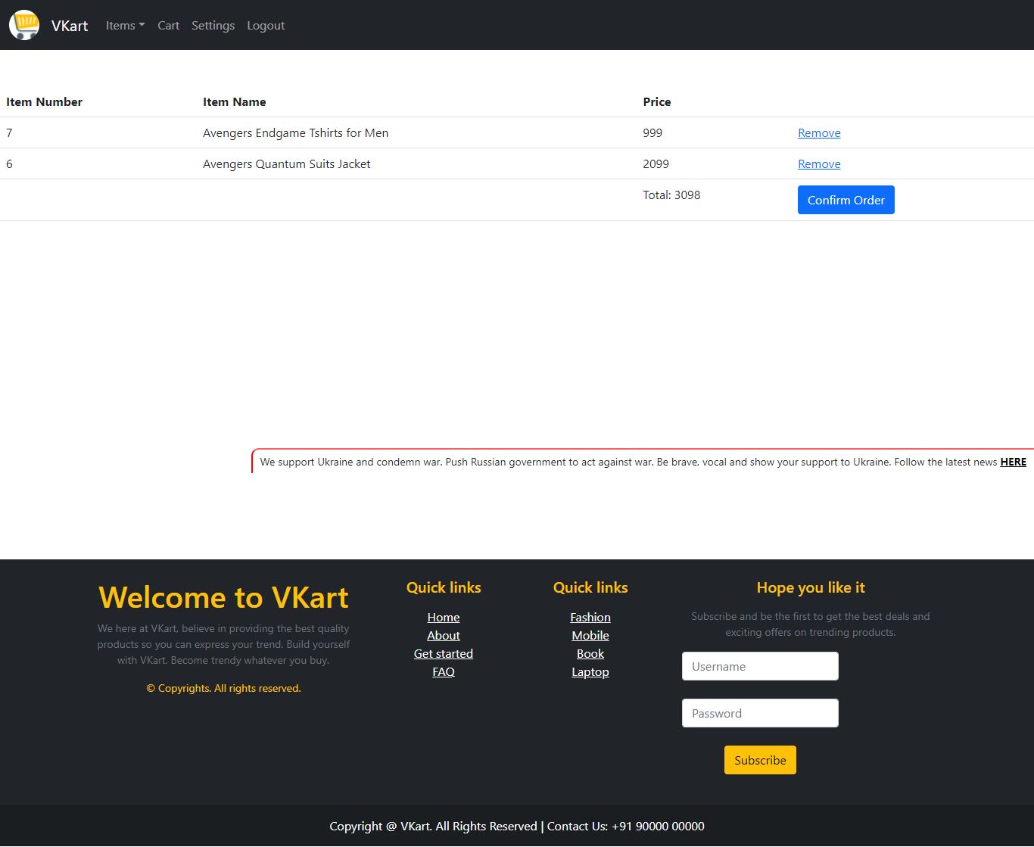
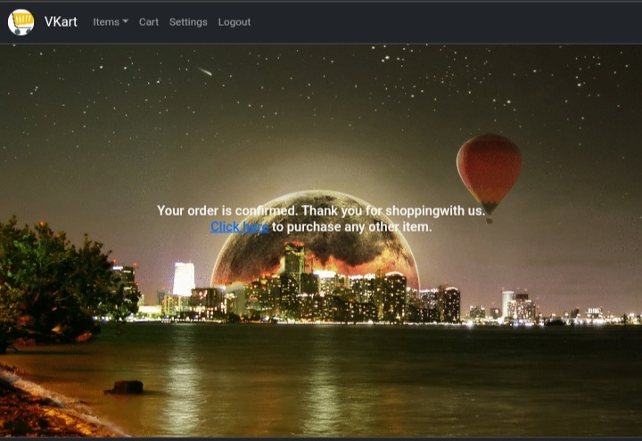
Web Page
Cart
Success

Slide 16

App
To access Vkart easily App is created.
VKart

Slide 17
Data Base

Slide 18
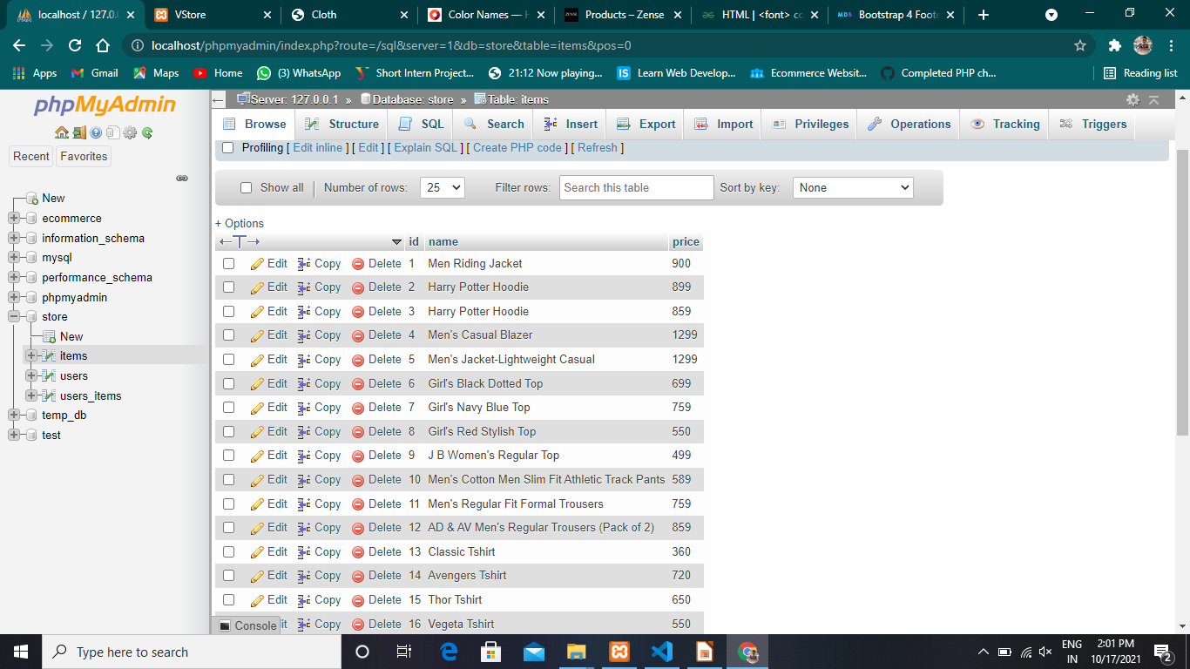
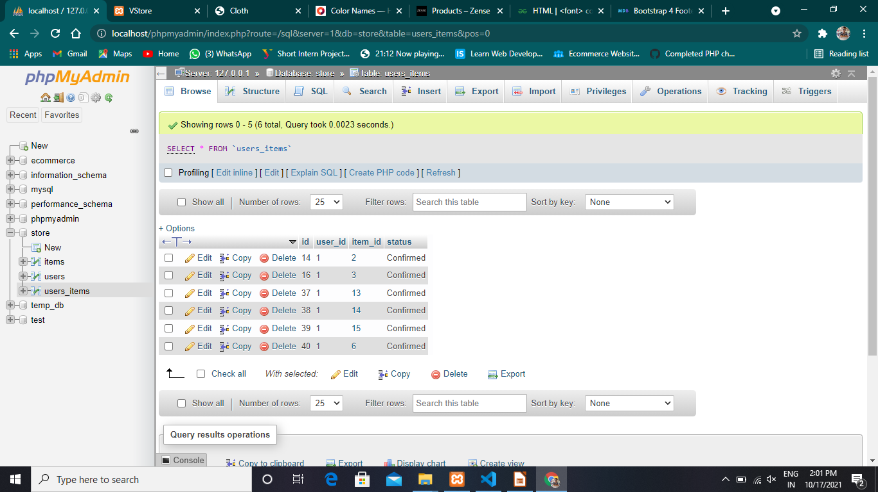
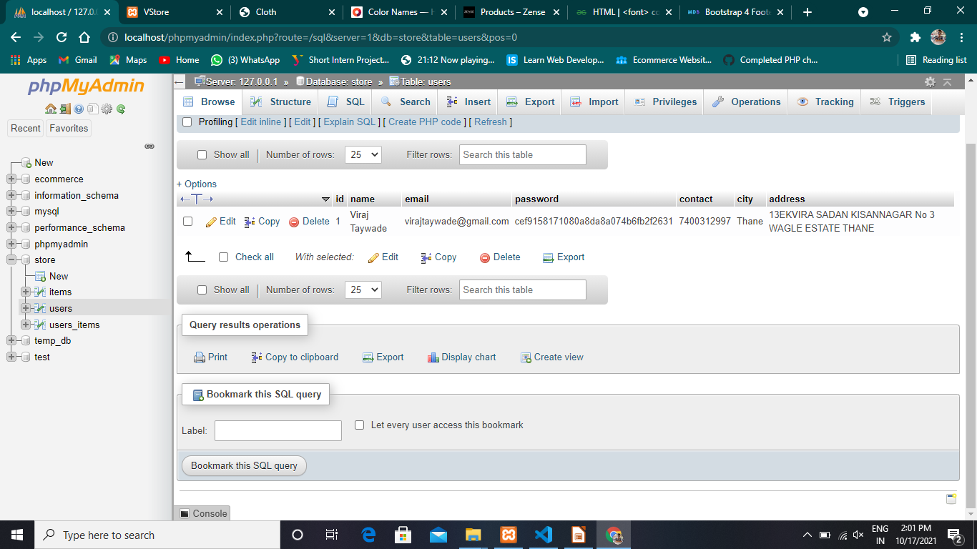
Data Base
ITEMS
USERS ITEMS
USERS

Slide 19
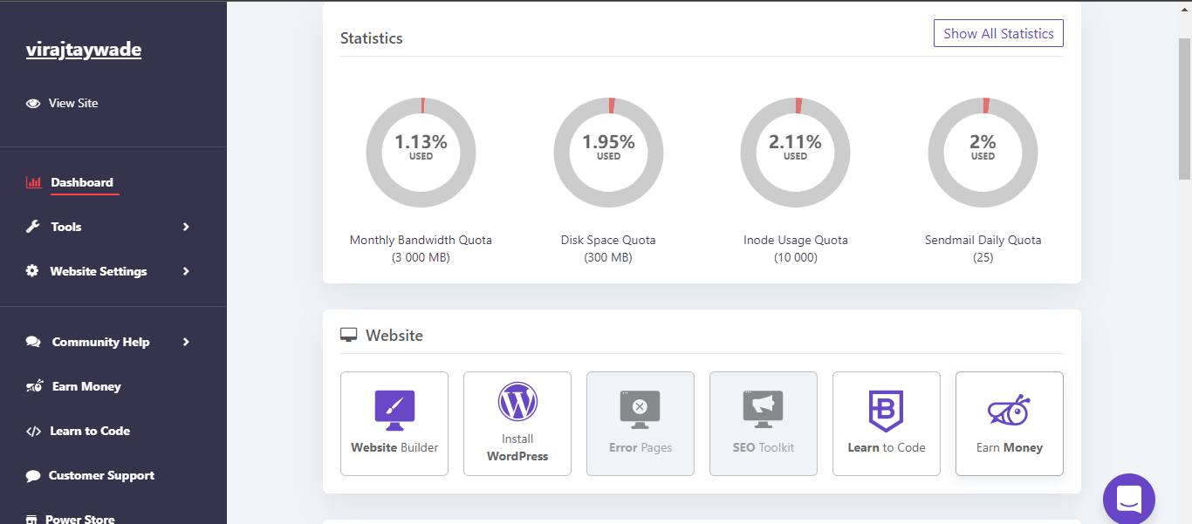
Web Host
The Webhost provides space to
upload files and database, so
it can be accessed online.

Slide 20
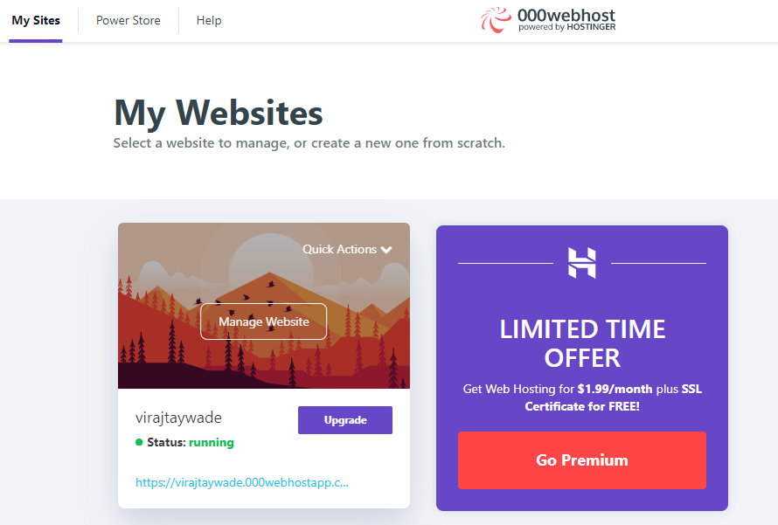
Web Host

Slide 21
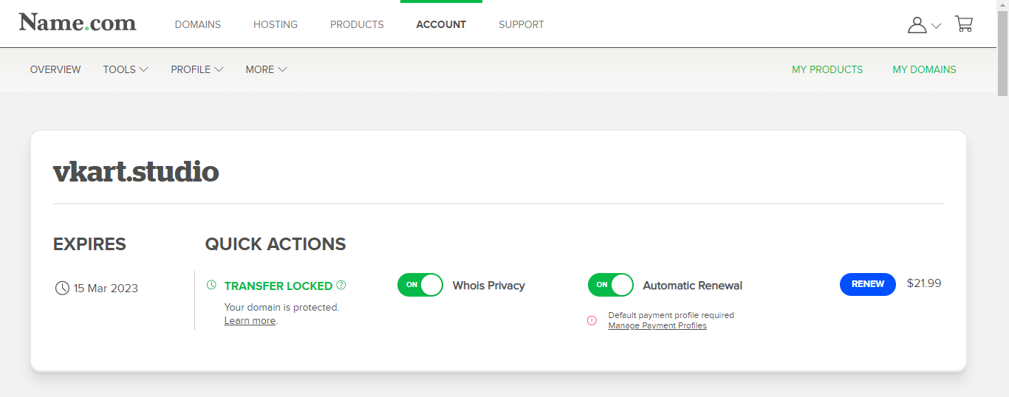
Domain
The main domain is vkart.studio . We are also
using sub domain as www.vkart.studio.
So it can be easily accessible.

Slide 22
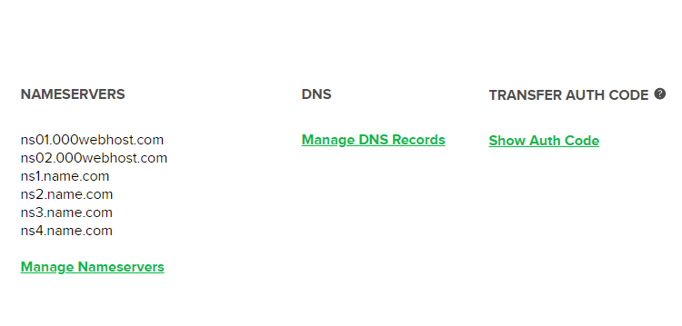
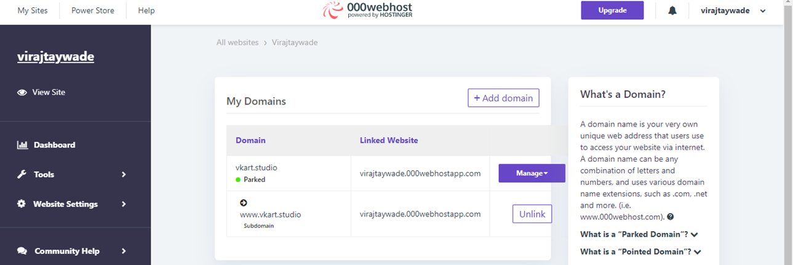
Domain

Slide 23
Conclusion
The Vkart is designed to provide 24x7 shopping .
It is a E-Commerce app and site where person can buy products from there
home or anywhere.
Customers can compare products easily without visiting from shop to shop.

Slide 24
Future Scope
More products can be added.
Vkart can provide platform for many Retailers.
More UI/UX and Animations can be added to make Vkart more attractive.
Options for delivery can be added according to when customer wants products to be delivered.

Slide 25
Reference
https://www.flipkart.com/
https://www.thesouledstore.com/
https://www.bewakoof.com/
https://mdbootstrap.com/
https://icons8.com/
https://dev.mysql.com/doc/
https://developer.mozilla.org/en-US/docs/Web/CSS/Reference
https://getbootstrap.com/

Slide 26
THANK YOU

